Slide 1






Crime and Environmental Factors
SRI SUDERSAN
RisHabH
Ridhan
Jeromey
Notes:
Jeromey

Slide 2
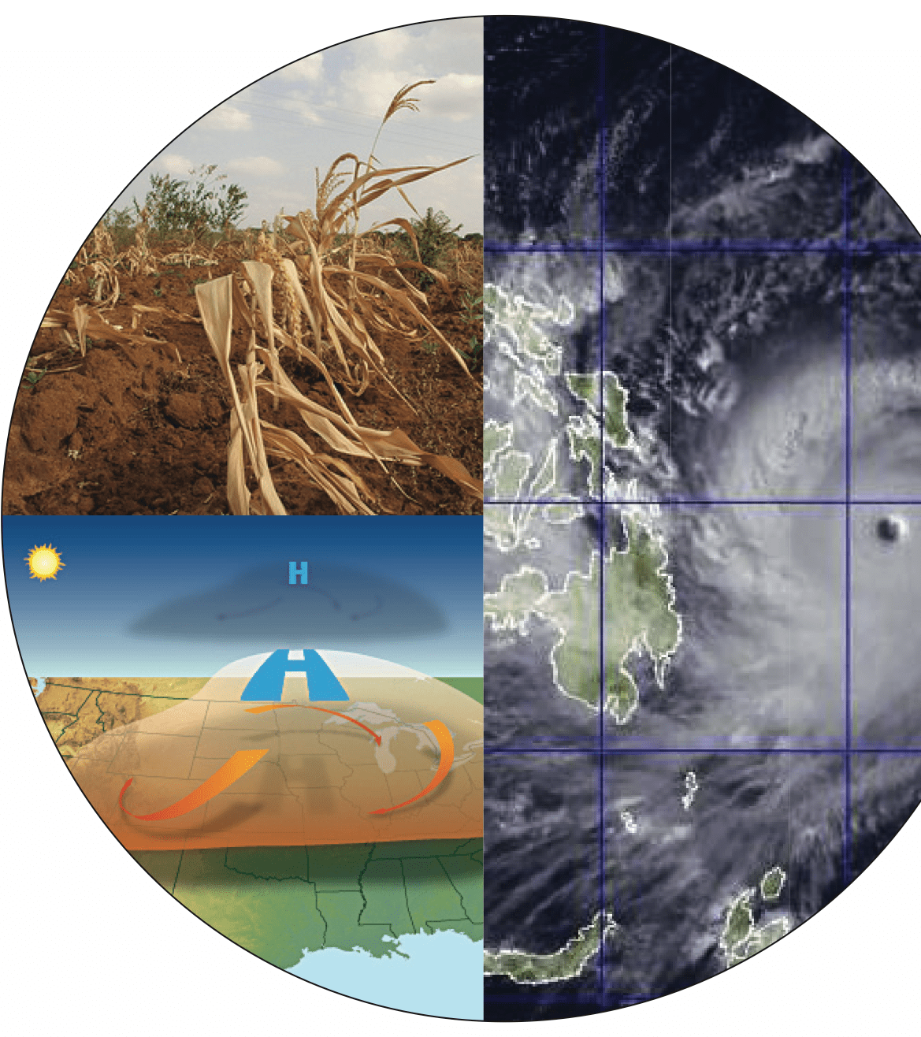
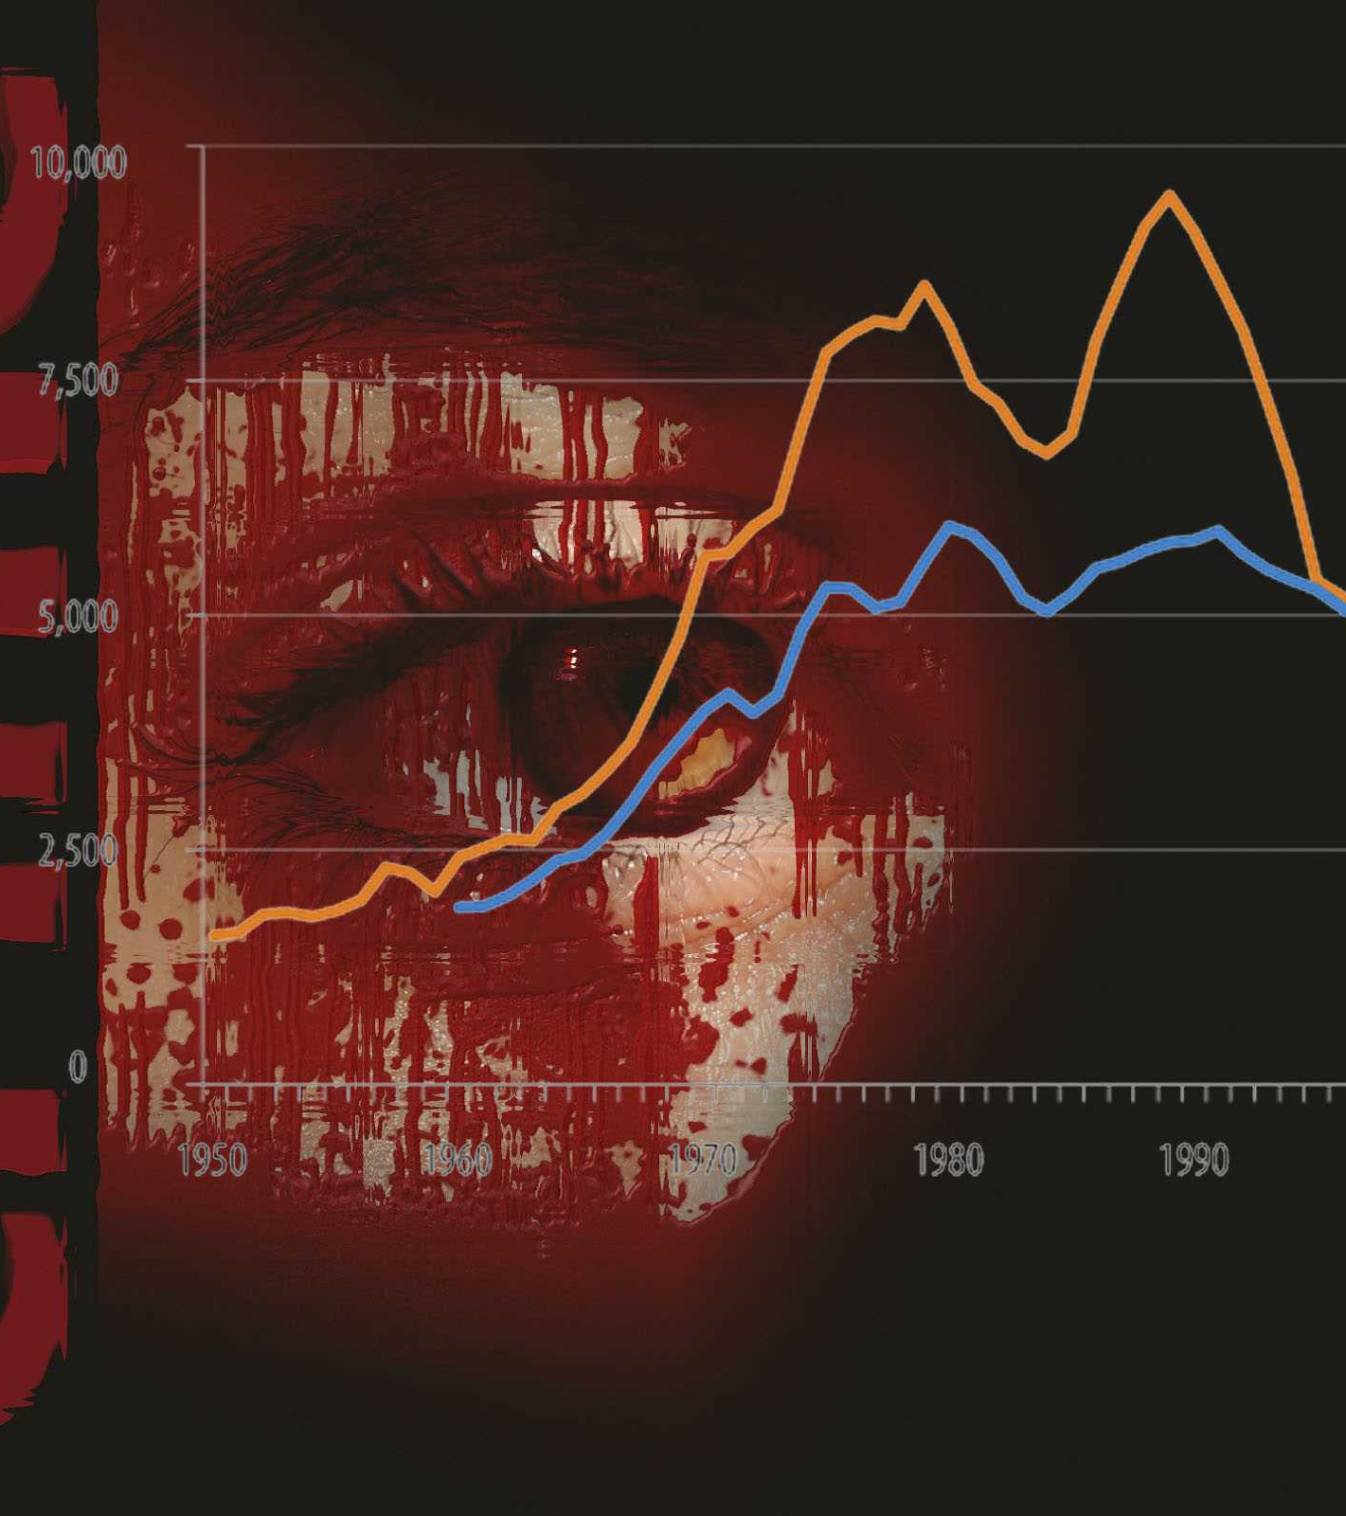
Introduction and Purpose of Dataset
Crimes are happening frequently on a random basis,
Correlation with crimes and other factors such as
Weather
Holiday events
Poverty/Low-income neighborhoods
Unemployment or stock prices falling which leads to inflation and prices increases
Notes:
Jeormey

Slide 3
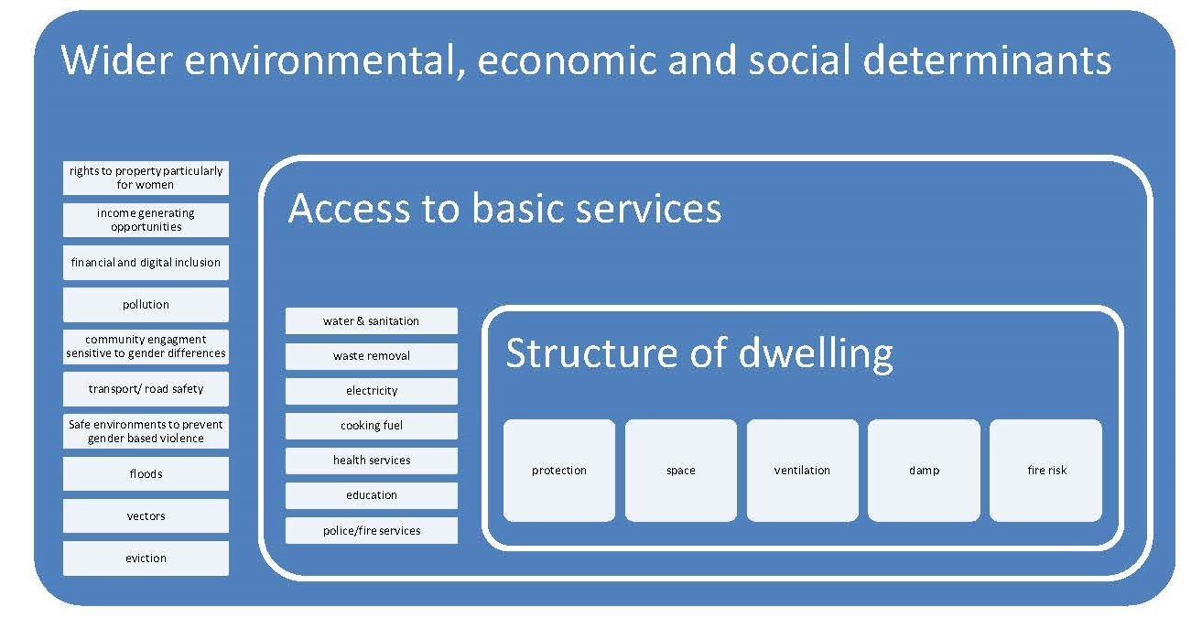
Understanding the need...
Notes:
Jeromey

Slide 4

Introduction and Purpose of Dataset
Other predictions and analytics like, The time zones during which the particular area would be hard to access or would be prone to crimes can be drawn from the given data.
With the timestamps in the data set, we can also predict the time of the years, seasons, and holidays on the days when maximum crimes take place. Also, by including Sensex and other economic data, we can trace the effect of the economy and the crime rate (theft, burglary, etc).
Expand our search to other major cities and compare the differences.
We believe this dataset would enable us to connect the dots and form a logical analysis
Notes:
Jeromey

Slide 5


Source of Data
We are using the following resources for creating our dataset.
OpenDataPhilly
Weather API
Holiday API
Twelve Data API – Stock market
Twitter API
True Crime Daily Website - Web Scraping
Notes:
Sudershan

Slide 6
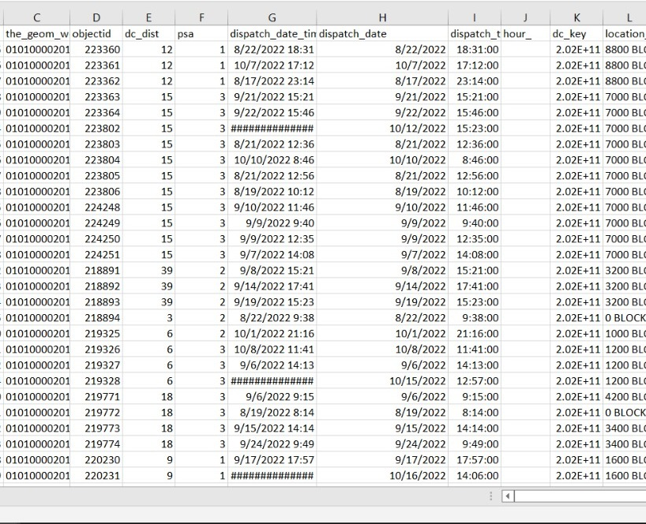
Raw Dataset
2 million rows of data
Notes:
Jeromey january to latest day. January 1st to November 23rd. Dataframe - Converted to csv cleaned all the unnecessary columns overall the number of rows was 2million but reduced to 300000

Slide 7
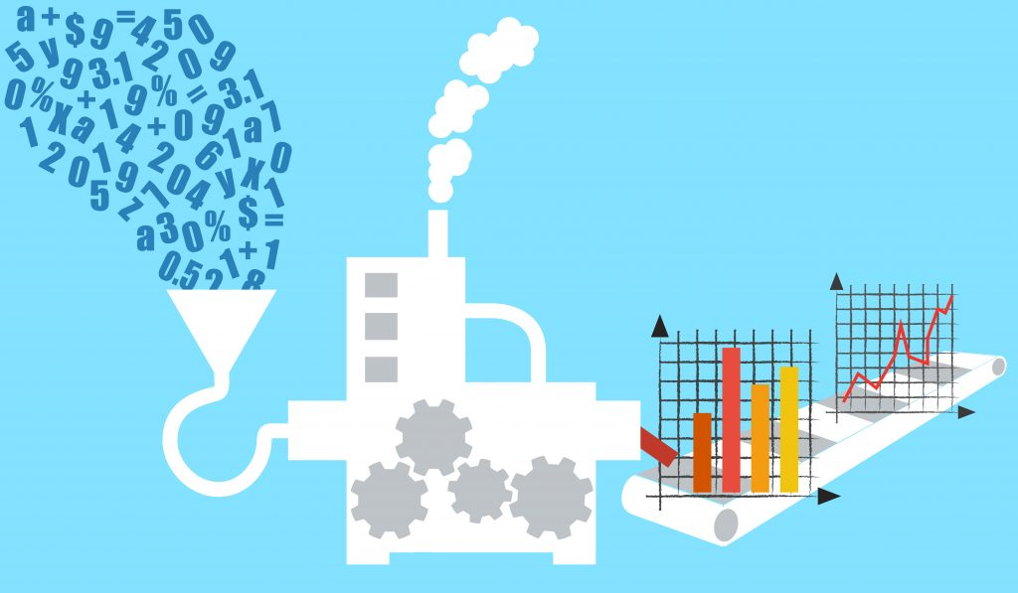
Approach to Preprocessing Data
Took only the column we needed from each data set
Making sure that the datasets had common key columns so that we could join the data sets with appropriate columns
Cleaned the data sets
Removed the null rows
Notes:
Jeromey

Slide 8
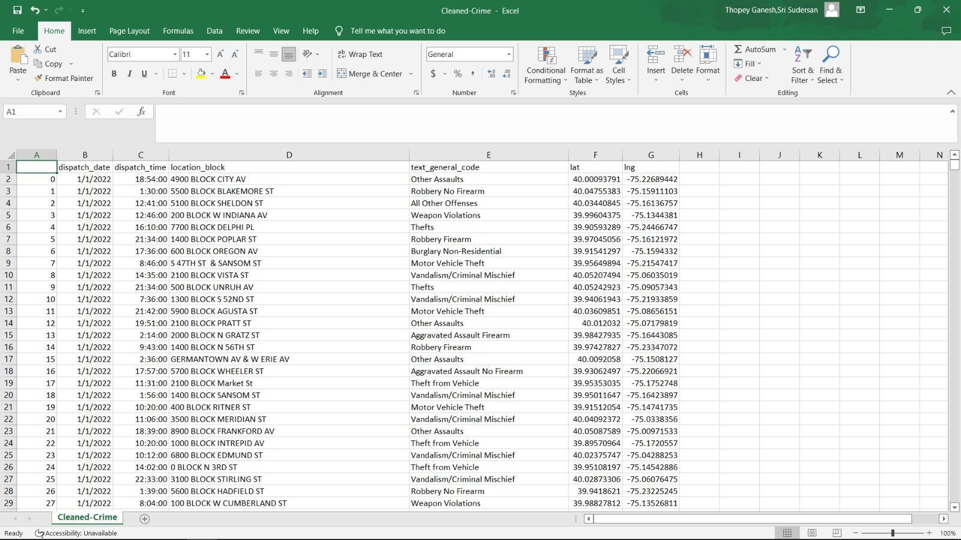
Cleaned Crime Dataset
300,000 rows of data
Notes:
Jeromey

Slide 9
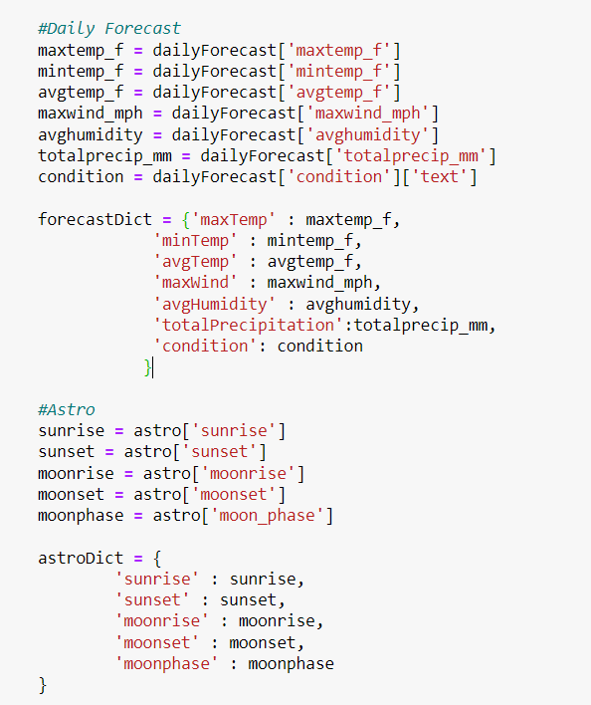
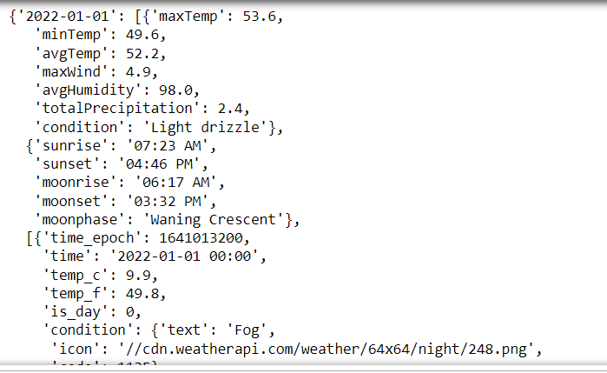
WEATHER RESPONSE
Notes:
Sudershan

Slide 10
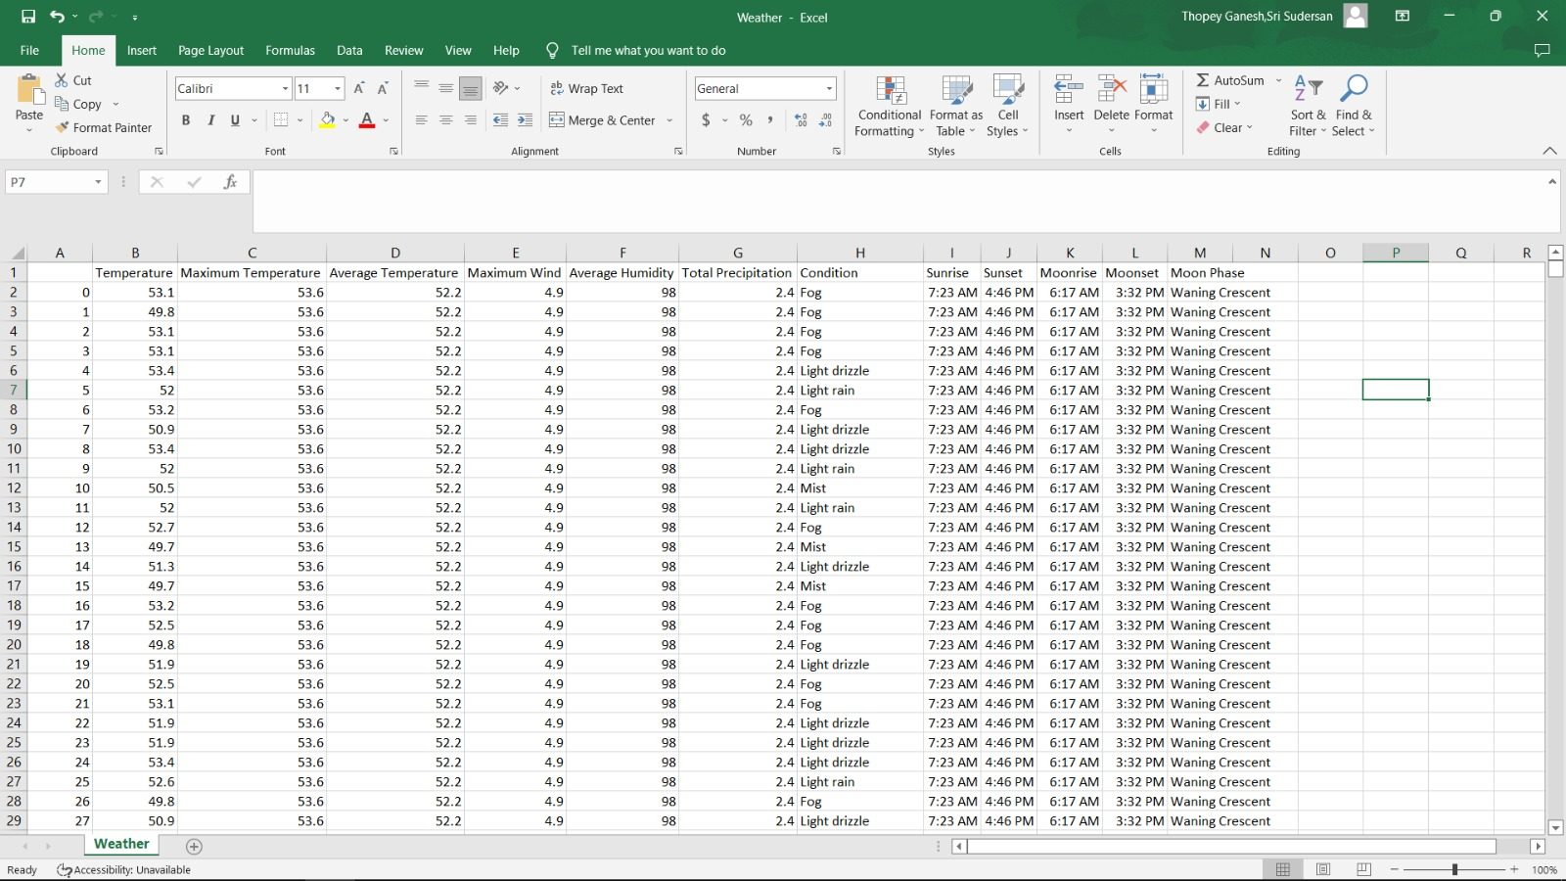
Weather Dataset
Notes:
sudersan

Slide 11
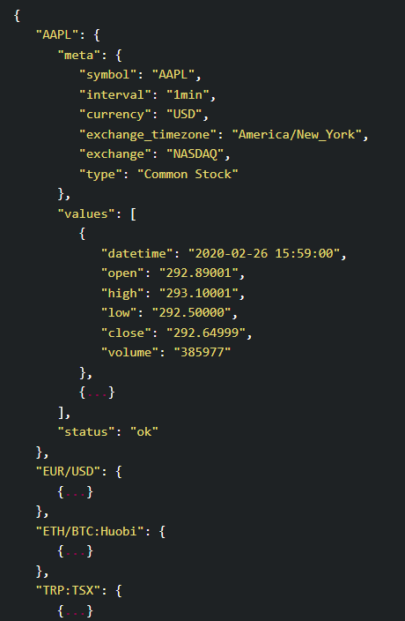
STOCK DATA API
Notes:
Ridhan

Slide 12
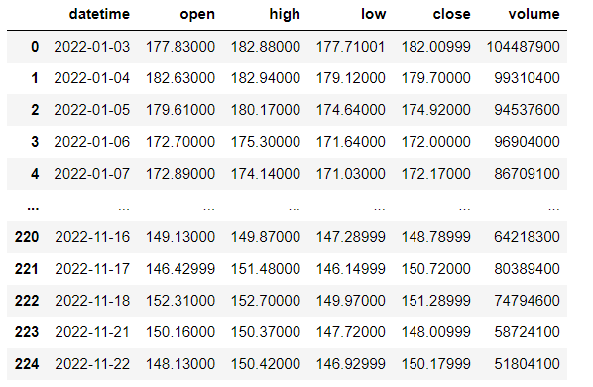
Stock Data
Notes:
Ridhan

Slide 13
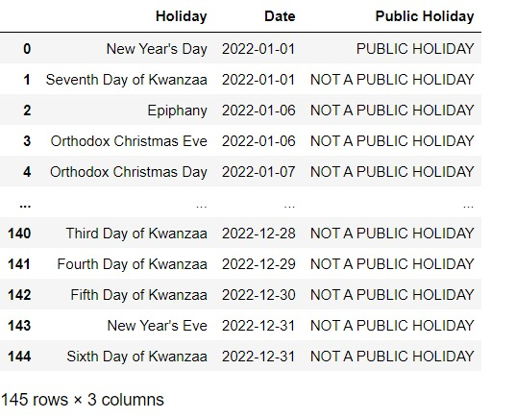
Holiday Data
Notes:
Ridhan

Slide 14
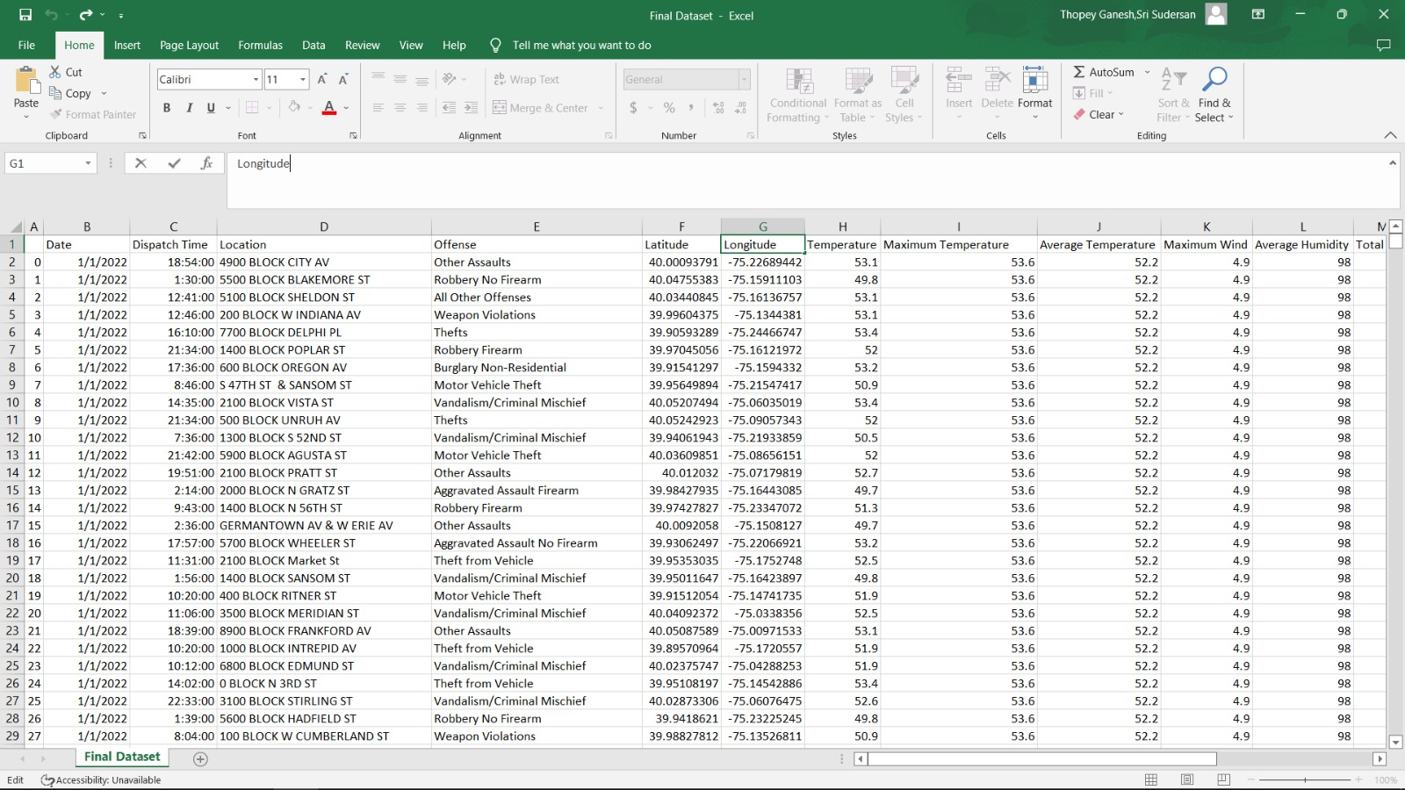
FINAL DATASET
Notes:
sudersan

Slide 15
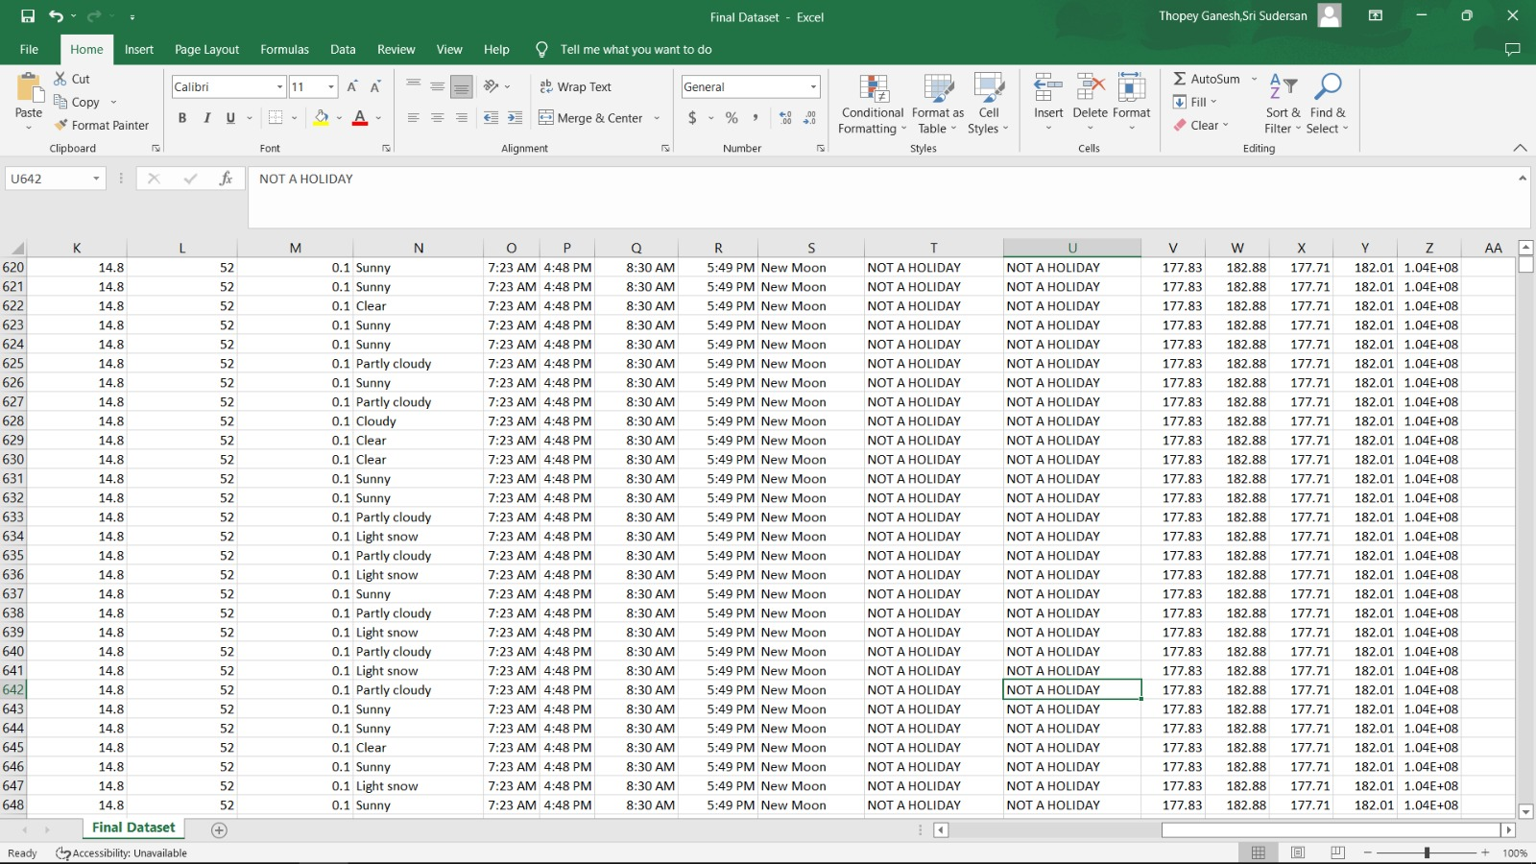
FINAL DATASET
Notes:
Sudersan

Slide 16
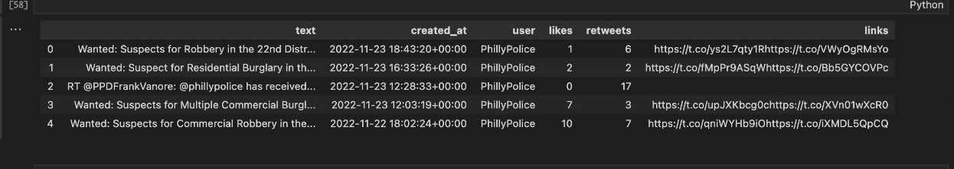
Tweet API Data
Notes:
Rishabh

Slide 17
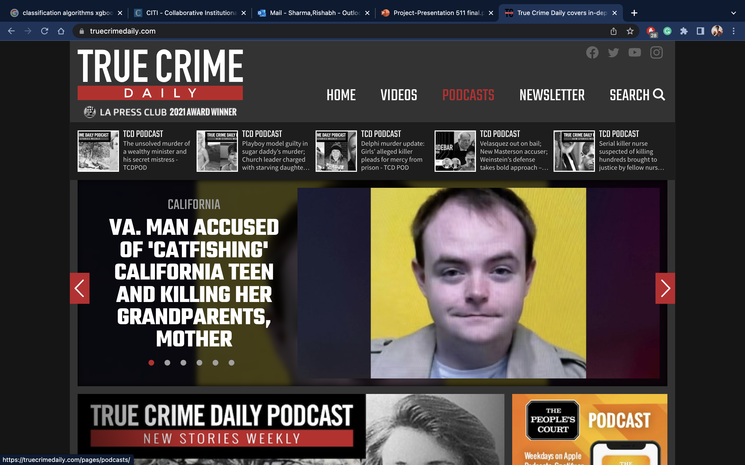
True Crime Website
Notes:
Rishabh

Slide 18
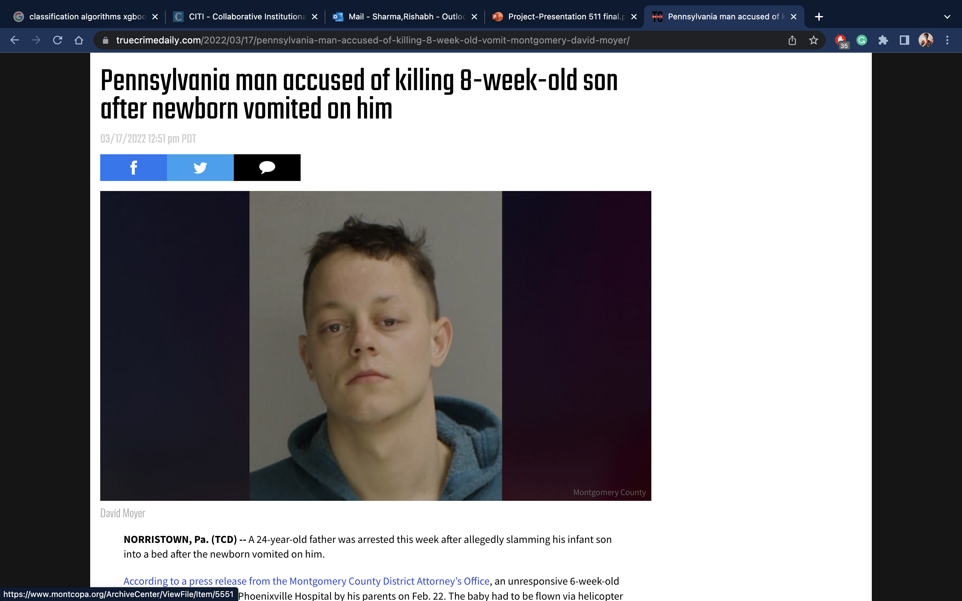
Blog pages
Notes:
Rishabh

Slide 19
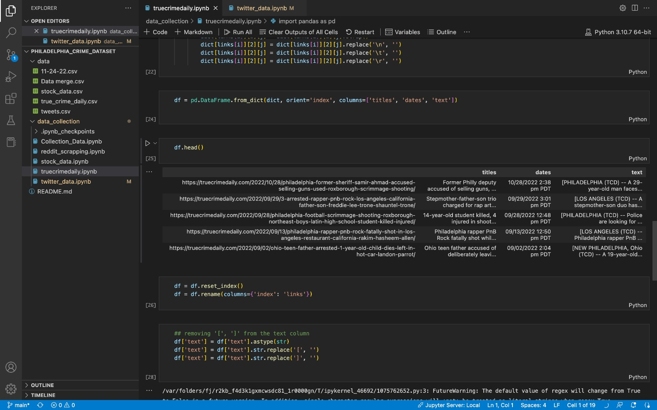
True Crime Daily - Web scraping
Notes:
Rishabh

Slide 20
Approach to Acquiring the Data
The major part of the data collection aspect of the project was to understand the information is gathered and shared
Researched the available API's and websites
Made sure the API's and website met our requirements
Twitter has many accounts that posts about Philadelphia crime data, we had to research the different accounts to pick the most appropriate account for our project.
Notes:
Rishabh

Slide 21

Potential Users and Applications
Law enforcement
Social workers
Real estate
This data set can be used by anyone looking to buy or renting a property in Philadelphia, the dataset can also be used to help various organizations provide services in the areas where crime is rampant to improve lives of people living in these neighborhoods
Notes:
sudersan

Slide 22
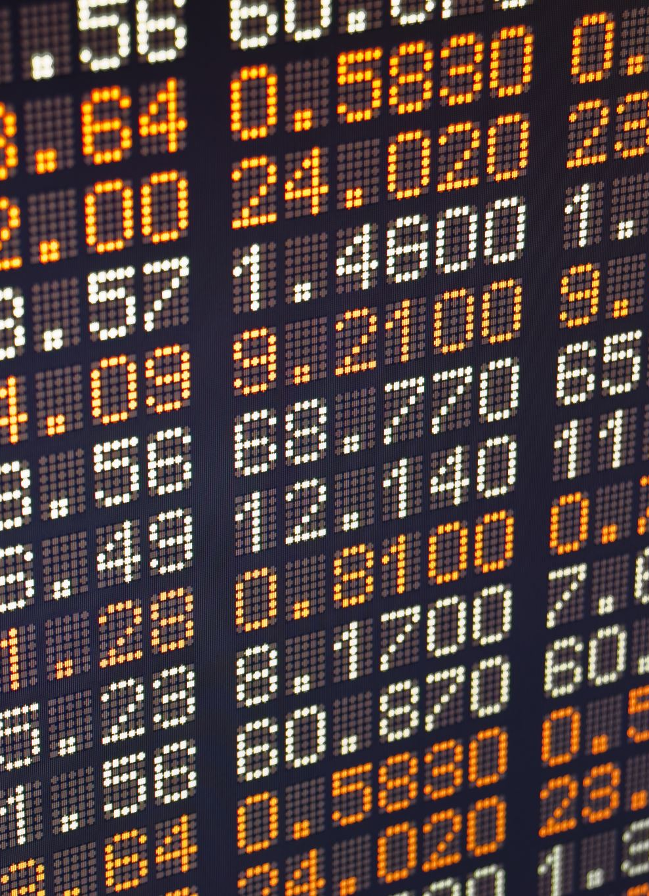
Discussion of Access Rights
OpenDataPhilly - Crime Dataset for 2022
Weather API - Free Trial for 2 weeks - 5 Million Calls/month
Holiday API - 10000 Monthly Requests - Restricted for Commerical Use
Stock Market API – Twelve Data - Opensource
Twitter API – 2 Million Tweets/Month, 300 calls/minute

Slide 23
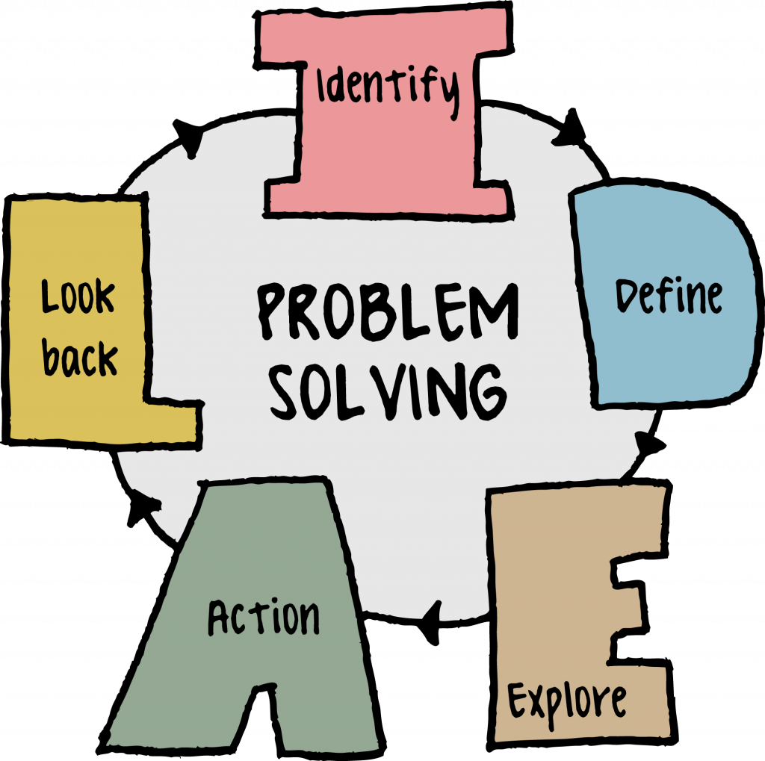
Issues and Limitations
The crime dataset although provides us with useful information, is missing certain details that can be used to gain various insights.
The True Crime daily and the Twitter data can't be merged with the crime, weather, and stock API. These datasets need to be used individually for the analytics

Slide 24
Team and Contributions
Sri Sudersan: extracted information pertaining to weather such as Temp, Humidity, Condition from weather API, Function Optimization & Rate limitation
Rishabh: scraped data from True Crime Daily website and Twitter API. Using the twitter and true crime daily we collected data with varied text data along with the date and time of the crime.
Ridhan: collected data from the Twelve data API for stock market and Holiday information from the holiday API. Ridhan created 2 df for stock market and holiday to store the unique information.
Jeromey: collected data for the crime incidents everyday for 2 weeks and converted all to CSV files and merged it.
Notes:
everyone

Slide 25
References
1. Jose, Joel Mathew. (2021). CRIME IS A RESULT OF SOCIAL AND ENVIRONMENTAL FACTORS AND NOT ON BIOLOGICAL FACTORS. International Journal of Current Advanced Research. 10. 23939-23941. 10.24327/ijcar.2021.23940.4743.https://www.researchgate.net/publication/350054152_CRIME_IS_A_RESULT_OF_SOCIAL_AND_ENVIRONMENTAL_FACTORS_AND_NOT_ON_BIOLOGICAL_FACTORS
2. Garnier, Simon and Caplan, Joel M. and Kennedy, Leslie W., Predicting Dynamical Crime Distribution From Environmental and Social Influences, Frontiers in Applied Mathematics and Statistics,2018 https://www.frontiersin.org/articles/10.3389/fams.2018.00013/full
3. Twitter Official API documentation - https://developer.twitter.com/en/docs/twitter-api
Notes:
Rishabh

Slide 26
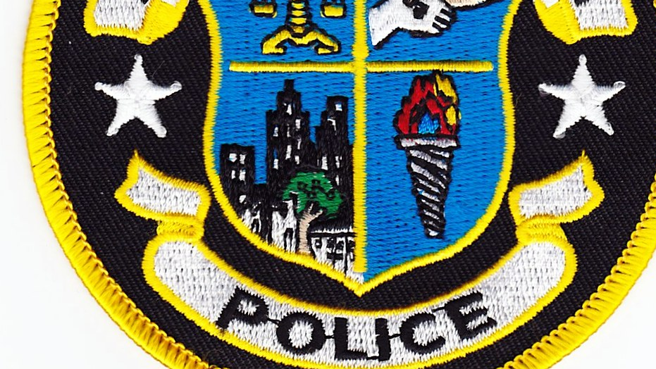
Thank You
This Photo by Unknown author is licensed under CC BY-NC.

